Slide 1
EMPLOYEES AND EMPLOYMENT TRENDS
IDENTIFY THE SELF STRENGHT

Slide 2
OBJECTIVES
At the end of this chapter, you will be able to:
Describe the materials and components of self strength
Recognise and identify a person’s strengths
Discuss on the important self strength

Slide 3
OUTLINE
Definition
Why is important
Identify self strengths
The strength-based assessment

Slide 4
What are strengths?
A particular way of processing information that your brain is good at.
Consistent near-perfect performance in an activity.
A part of your brain that’s more efficient than other parts.
An activity that makes you feel strong.
A combination of talents, skills and knowledge that are consistently and productively applied to achieve a desired result.

Slide 5
Question?
If you were to create a word cloud to show an employer your greatest strengths, what would it say?

Slide 6
There are 3 raw materials of strengths:
• Talents
• Knowledge
• Skills

Slide 7
Cont…
T A L E N T S
A talent is a naturally recurring pattern of thought, feeling, or behavior.
Talents endure because they were “hardwired” into your brain.
K N O W L E D G E
Knowledge is a mix of facts and lessons you’ve learned.
Factual knowledge won’t guarantee excellence, but excellence is impossible without it.
S K I L L S
The ability to do something well.
Skills are generally developed through a combination of practice and aptitude.

Slide 8
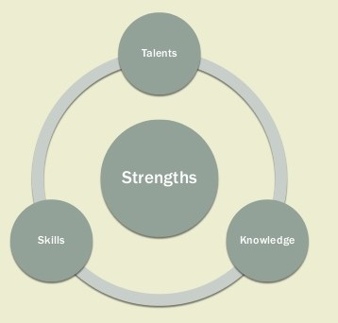
The key to building your strengths is to identify your dominant talents and then refine them with knowledge and skills. Strengths Talents Knowledge Skills

Slide 9
Why is it important to identify your strengths?
❖ Sets you apart from everyone else
❖ Leads to greater personal and professional development
❖ Improves effectiveness
❖ Makes your life more productive and fulfilled
❖ Helps you experience a feeling of “rightness”

Slide 10
How can you identify your strengths?
1. Questionnaires
2. Self Reflection

Slide 11
Questionnaires
❖ Help you dig into personal insights
❖ Give a better understanding and description of your values
❖ Let you know what kind of work environment you will enjoy and excel in
❖ Show you how you can enhance your strengths and develop your weaknesses

Slide 12
Self Reflection
A sure way to identify your strengths and talents is stepping back and watching yourself for a while.
4 clues to identify your strengths through self reflection:
Spontaneous Reactions
-How do you react to situations you encounter?
2. Yearnings
-What strong connections keep calling out to you? 2.
-What activities do you want to repeat?
3. Rapid Learning
-What do you learn more quickly than other people?
-What do you have a desire to learn more about?
4. Satisfactions
-What activities do you feel good about?

Slide 13
Use the SIGN Method: Self Reflection
Success
❖ Using your strengths makes you feel successful
Instinct
❖ Activities you are naturally drawn to
Growth
❖ Where you learn the most, come up with new ideas, and have the best insights
Needs
❖ Where you feel the need to spend the most time

Slide 14
Self Reflection Bonus! :
Use others to find your strengths
❖ What do others ask for your help with?
❖ What do others want you to teach them?
❖ What do you receive compliments for?
❖ Simple but effective: just ask family, friends, and coworkers what they think you’re good at!

Slide 15


Slide 16
STRENGTH BASED ASSESSMENT
6 essential components of strength identification
1. Performing it in a context that makes sense for the person
2. Conducting it as an open discussion (not as an interrogation)
3. Following the person’s rhythm
4. Continuous updating
5. Using the person’s words
6. Complete and specific

Slide 17
Don’t ignore your weaknesses…
Identify them
2. Outsource them
3. Systematize them
4. Minimize them
5. Improve them Manage them!

Slide 18
THE END

